Slide 1
Welcome to St. Peter’s Bratton Church of England Academy

Slide 2
Our vision:
Enriching lives everyday; to enable our school community to learn, achieve and flourish through living ‘life in all its fullness’

Slide 3
Our Values
Excellence, Nurture, Respect, Integrity, Compassion, Hope (ENRICH)
You can find out more about our vision and values by clicking here, where you will also find a link to our strategic plan for the next few years.

Slide 4
Church of England schools are, by law, set up for a Christian vision of education.
Part of our core expectation is our Christian vision and values and that flowing through all that we do.
We are part of the St Chad’s Academies Trust - A family of schools who work together to ‘Put Children First’
Set up by the Diocese of Lichfield, it consists of 19 Church of England Primary Schools and 1 Middle School.

Slide 5
Our results and standards
Children achieve well by the time they leave St Peter’s
Our achievement is above the national averages
We are in the top 20% for achievement in maths – at both higher level and expected level
In writing we are in the top 20% for achievement at the higher level of writing
Progress is very good across reading, writing and maths
Absence is in the lowest 20% when compared to similar schools nationally

Slide 6
EYFS Curriculum is very different from the rest of the school. A lot of learning is taught through games and play..
The curriculum covers these areas:
Personal, social and emotional development
Communication, language and literacy
Problem solving, reasoning and literacy
Knowledge and understanding of the world
Physical development
Creative development
Useful information –
Development matters

Slide 7
The Curriculum
English – reading and writing
Mathematics
Science
PE
History
Geography
Art
Design and Technology
Computing
Music
Languages
Religious Education
Personal, Social and Health Education

Slide 8
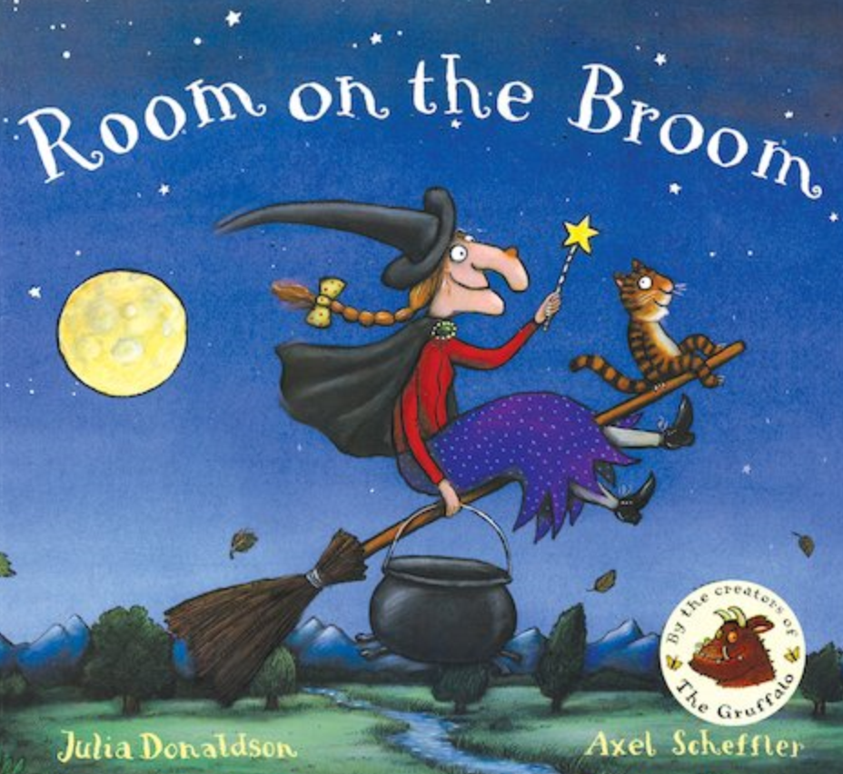
In school, our highest priority is reading because it’s the route to learning in every other area.
You can help by reading to your child. Authors such as : Judith Kerr , Julia Donaldson, Dr Seuss and Maurice Sendak are particularly good.
Reading

Slide 9
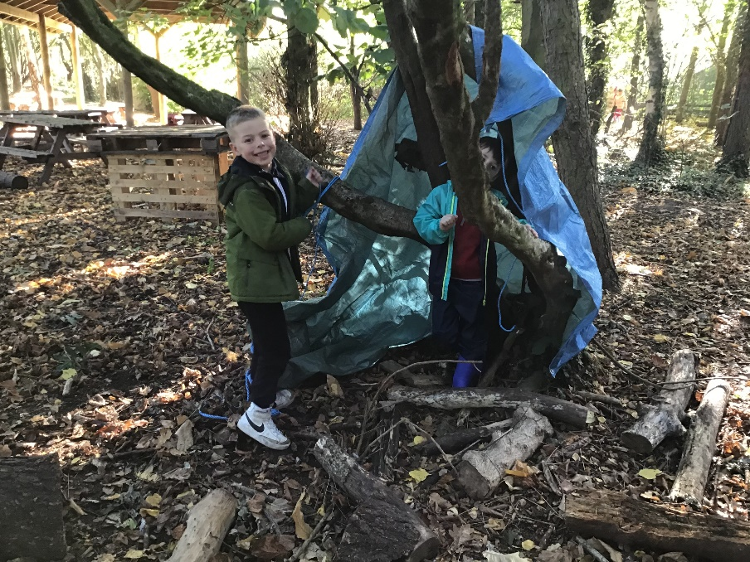
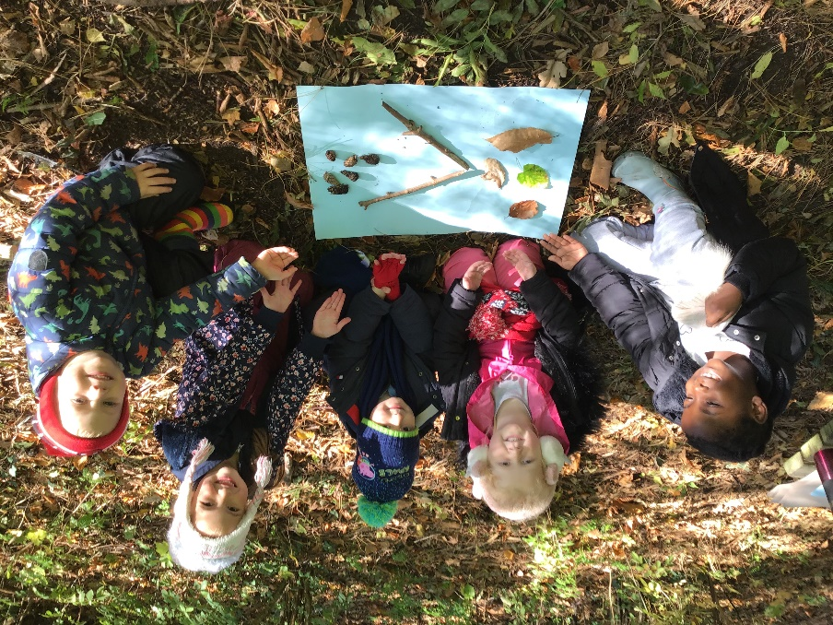
Squirrel School

Slide 10
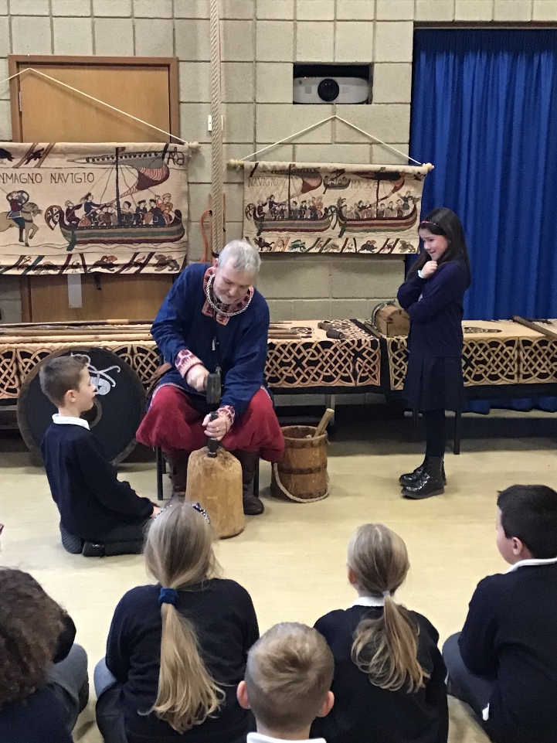
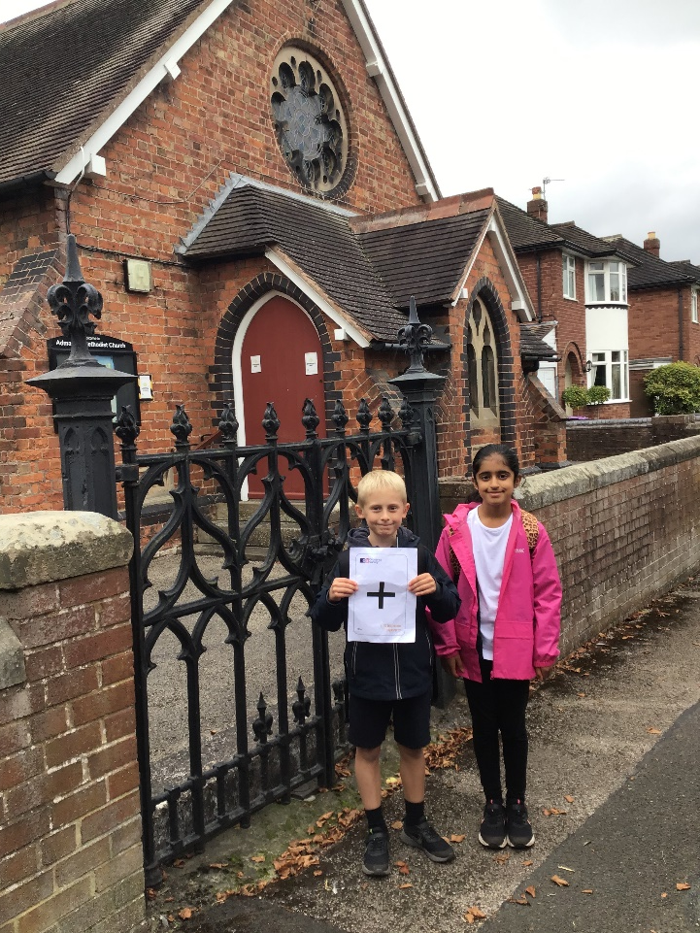
Visits and Visitors

Slide 11
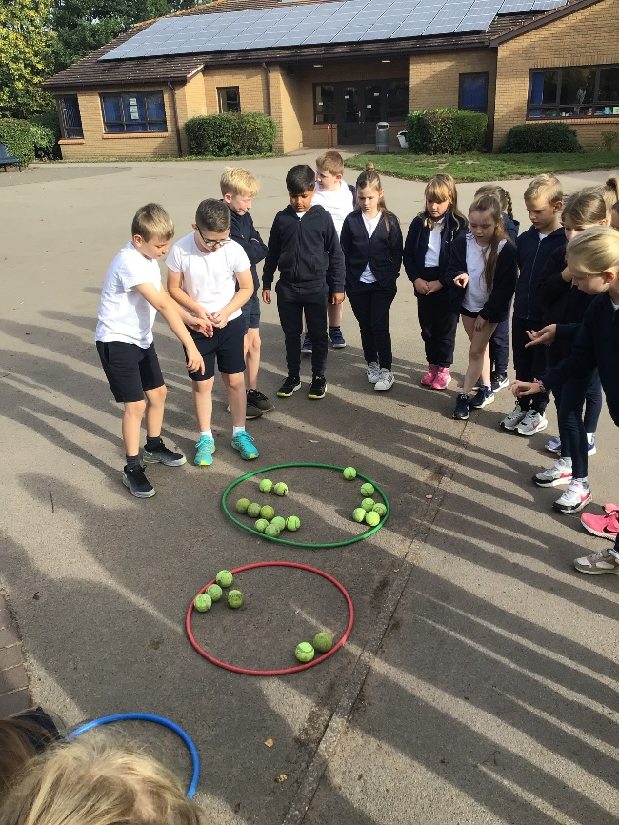
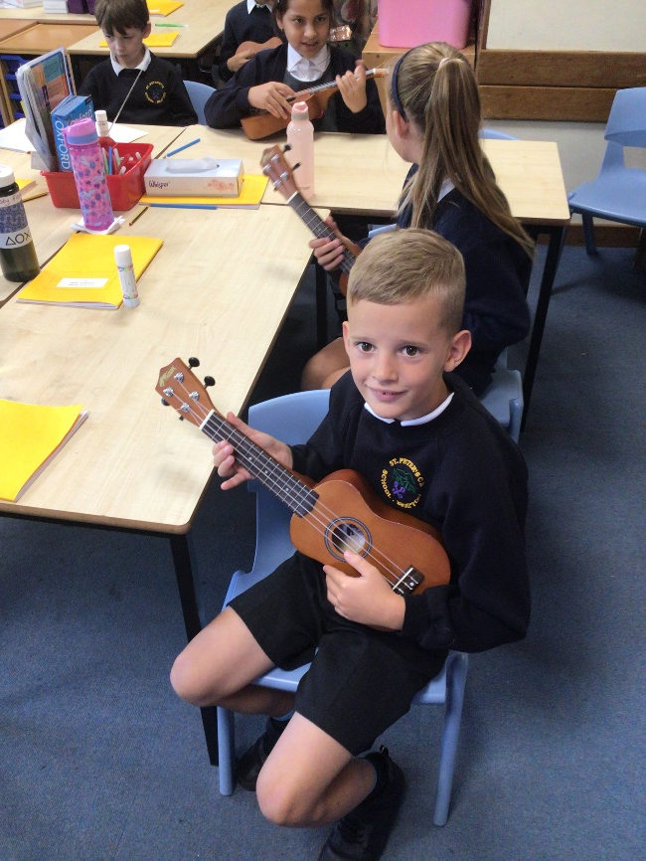
Lots of practical activity…

Slide 12
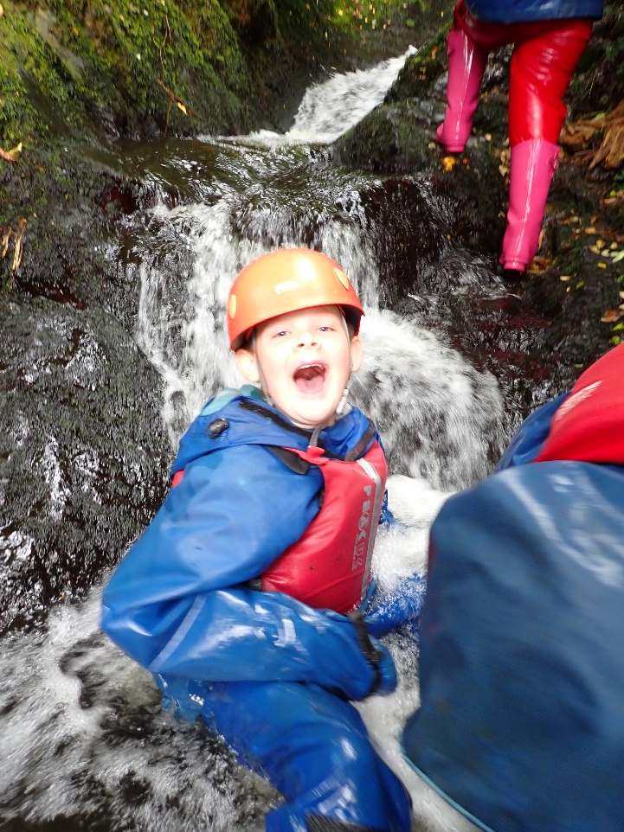
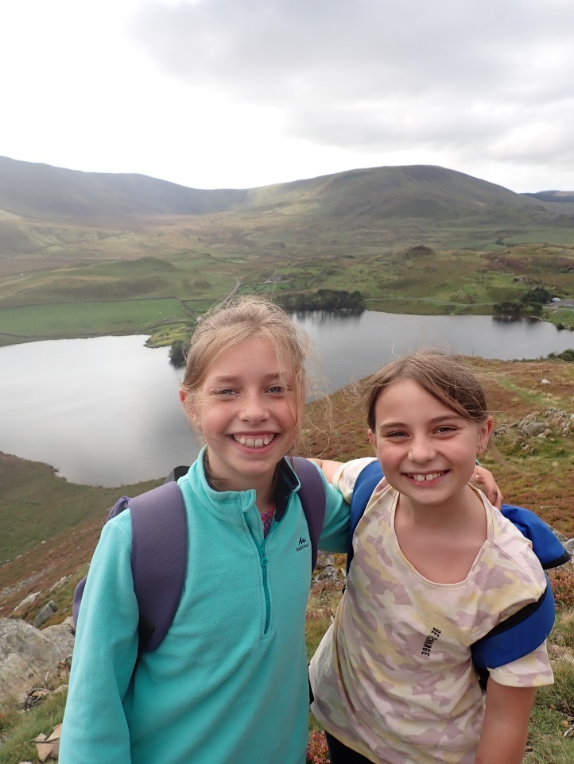
Residential Visit

Slide 13
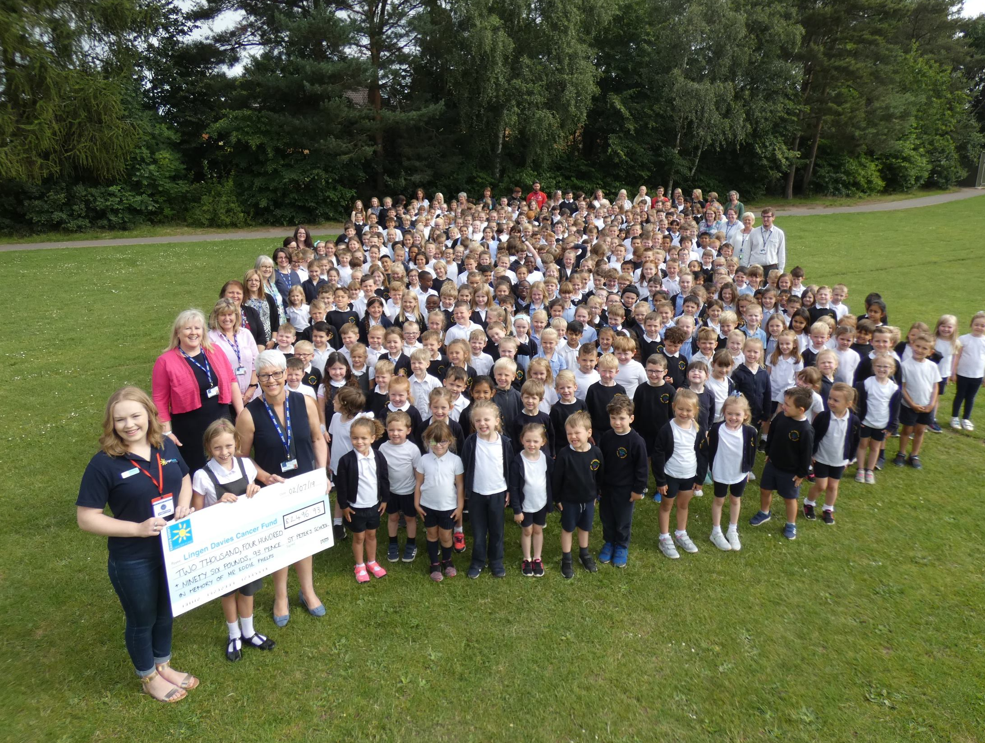
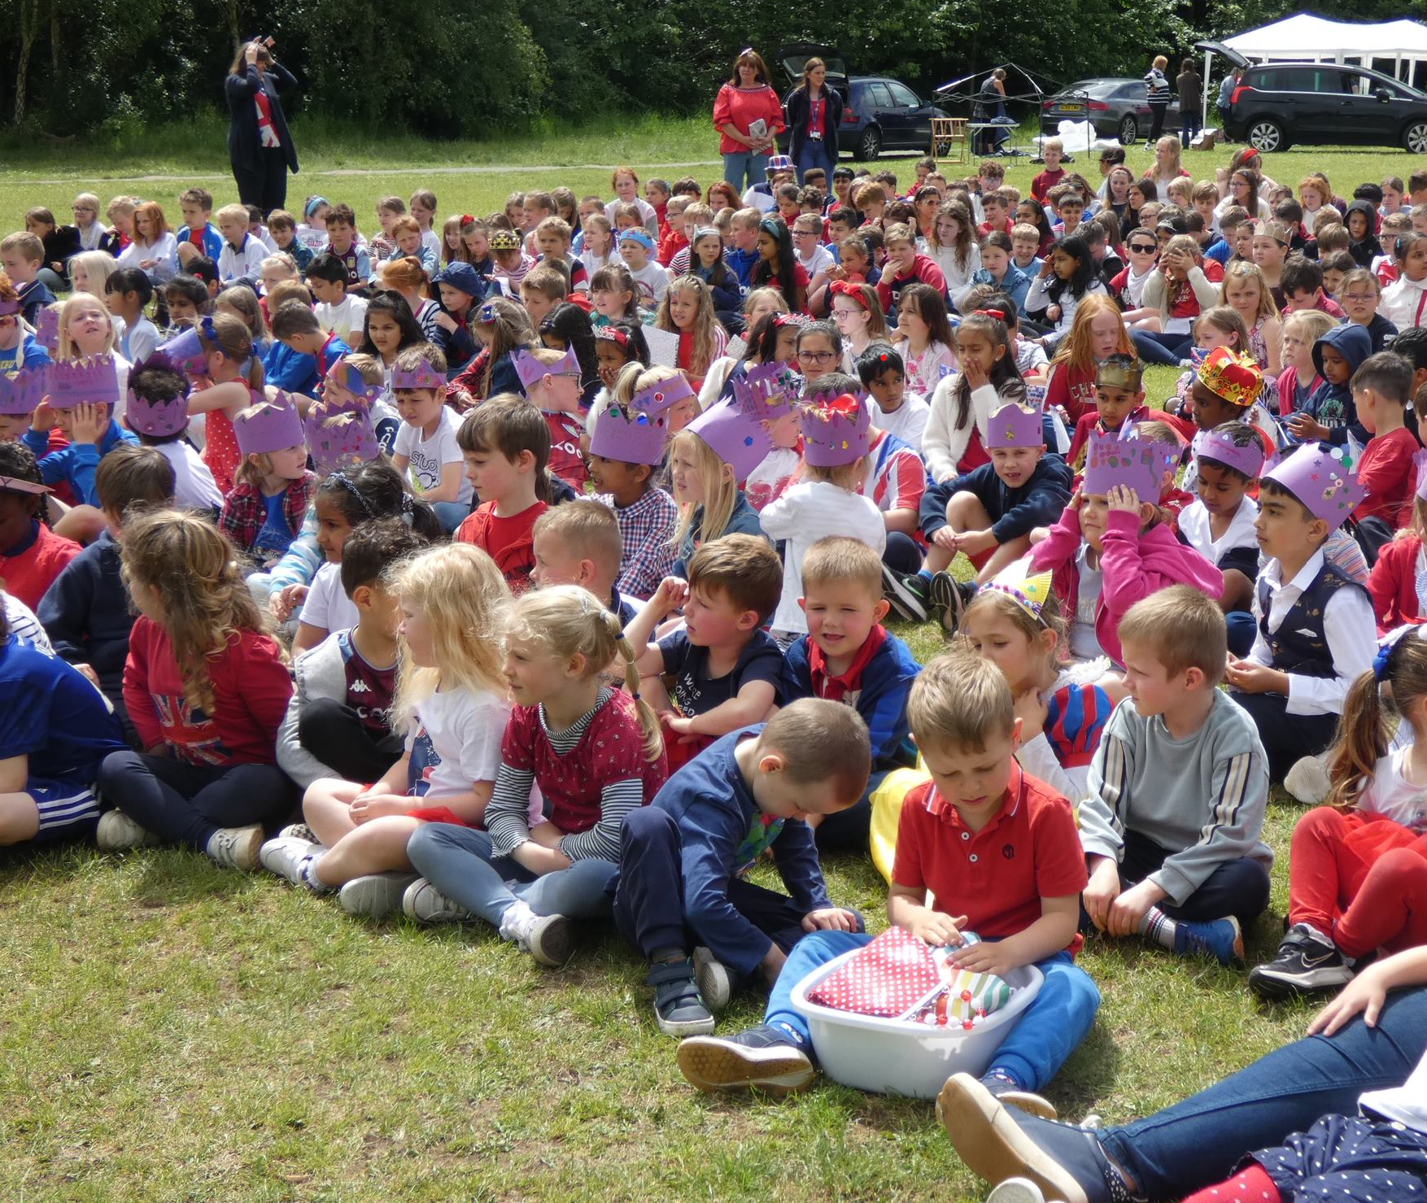
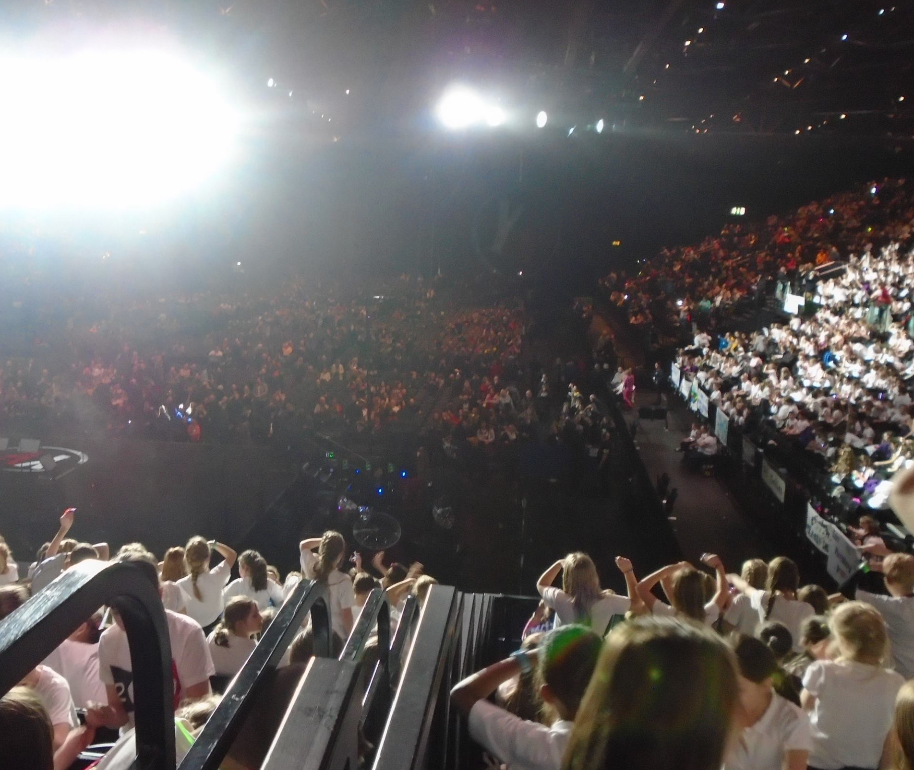
Lots of experiences…

Slide 14
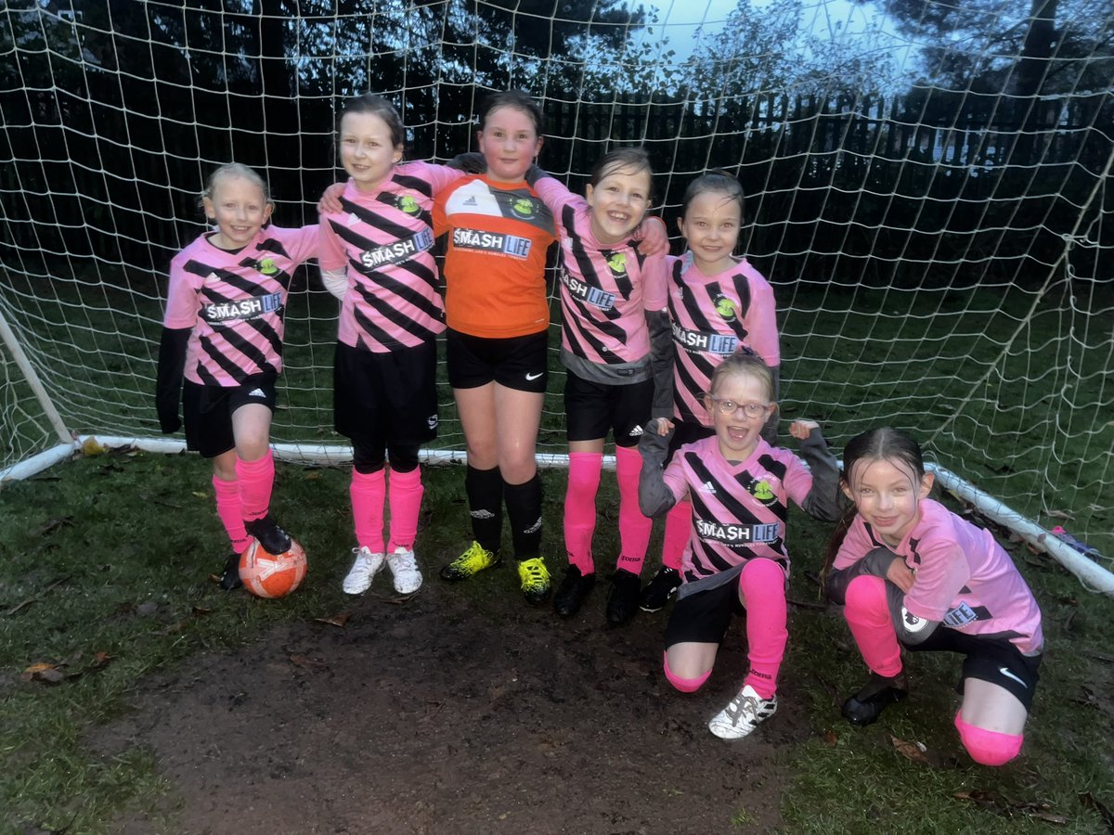
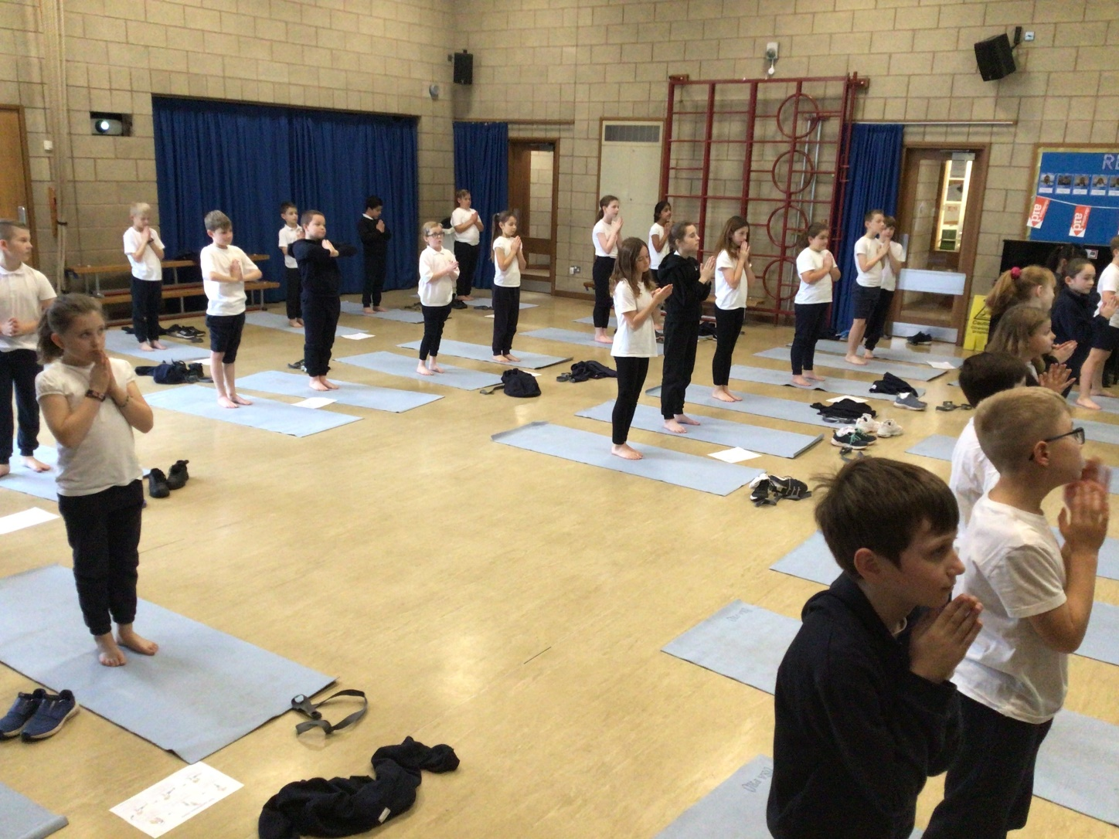
Sport

Slide 15
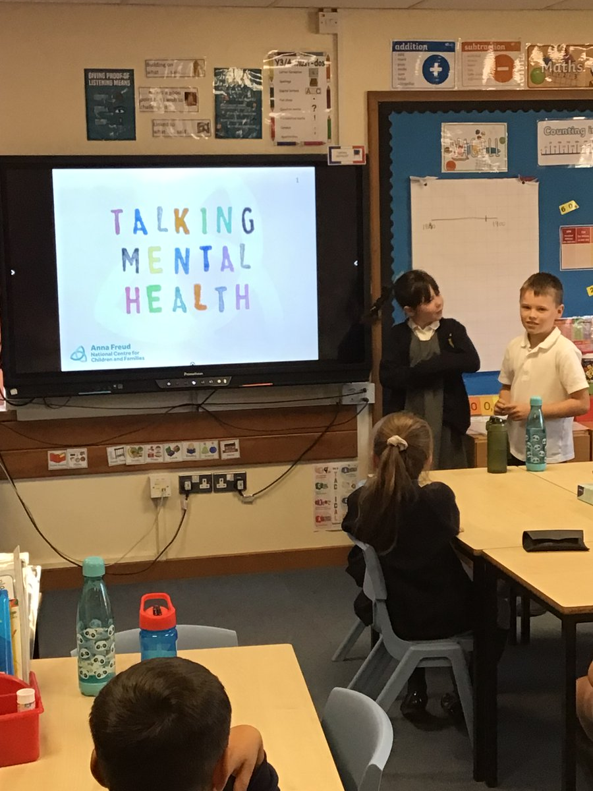
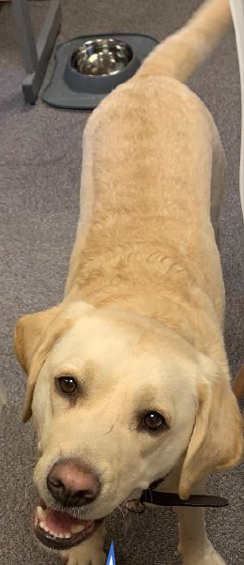
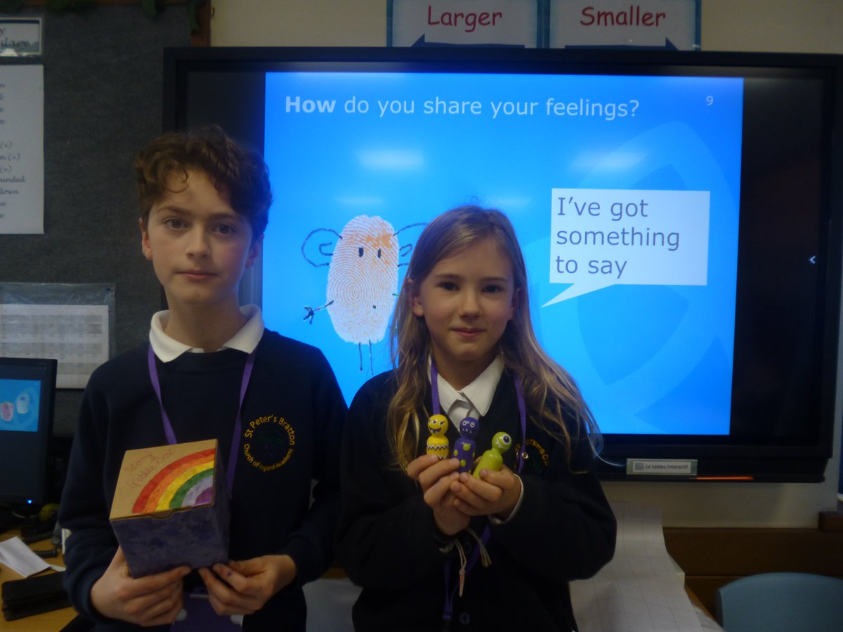
Taking part and looking after ourselves

Slide 16
Wrap around care:
We run our own wrap around care on the school site
We offer:
7.30am – 8.45am (Currently £4.20 a day)
3:15pm – 6:00pm (currently £9.20 a day)
Plus holiday club for 10 weeks a year (out of the 13 weeks of holidays) - £20 – £25 a day.

Slide 17
Safeguarding
Safeguarding is the highest priority in school
We have 10 designated safeguarding leads – which includes our senior leadership team, phase lease leads, pastoral support lead and members of wrap around staff.
They are highly trained and know what to do!
All our staff receive safeguarding training, which includes anti bullying, e-safety, peer on peer abuse to name but a few.

Slide 18
Pastoral support
It’s for the children and for you.
We deal with a huge spectrum of issues.
There is very little we have not heard before! We need to know when things have gone wrong as things at home do impact children in school.

Slide 19
School transport
If you are in our catchment area and and you are more than 2 miles away OR, we are there is no safe walking route, you may qualify for free transport.
You need to contact transport@telford.gov.uk

Slide 20
Communication:
Weekly newsletter by Parentmail
Text service
Communication at the door / on the playground
Twitter
Website
Members of the Senior Leadership Team on playground at start and end of day

Slide 21
Starting reception:
It’s really helpful if your child knows or can practise these things before September…
Kicking a ball
Using a pencil
Using a knife and fork
Sitting still and listening to a story
Understanding the words ‘no’ and ‘stop’
Taking off their coat
Putting on their shoes
Going to the toilet

Slide 22
Email: stpetersbratton@taw.org.uk
Tel: 01952 387980
Twitter: @st_bratton

